Slide 1

BLOOD DONOR AND USER COMMUNICATION SYSTEM USING IOT AND GSM
PRESENTED BY
DHARANI KANNA K V
KAALIDAS S
SREERAG P
THARANI DHARAN PR
Guided by
Ms.s.Nagammai M.E

Slide 2
ABSTRACT
In the First process we have separately provided buttons to select the blood group. After pressing the required blood group bottom.
The blood type was check over the blood bank database. If there is non availability of the blood it was jump to the next step.
The blood required data was sent to all the donor who have similar blood group via Internet of things app and SMS. This request message With data’s like contact number and blood group type.
Waiting for the “Yes” or “No” response from the donor. If the response get from the donor then the data shown on the same device which is used to requested for blood.
At the same time request sent to the our mobile application users for more response.

Slide 3
OBJECTIVE
Automate the communication process to make emergency alert for the donor.
Low cost and Effective, efficient method for searching healthy and nearly blood donor.
Direct communication between the blood donor and blood requesting person

Slide 4
LITERATURE SURVEY
AUTHOR | TITLE | DESCRIPTION | DRAWBACK
Prof . Snigdha et.al | Android Blood Bank | Correlation between existing blood bank framework and enhanced framework to improve the effectiveness. The new considerations may increase the efficacy of current blood banks and help to upgrade from ordinary desktop framework to portable framework. | This is a blood bank database connecting protocol system.
Narendra Gupta et.al , “MBB | A Life Saving Application | It was an application with nearby donor detail. In case if the first donor is not available it will automatically search the next donor which is present in queue. | This is looped process and take time to reach donor.

Slide 5
LITERATURE SURVEY
AUTHOR | TITLE | DESCRIPTION | DRAWBACK
Sultan Turhan | An Android Application Volunteer Blood Donors | A smart phone application is developed to facilitate the identification of the nearest available blood donor volunteer and the communication with him/her in the emergency situations. | This is used by the particular person who owned the mobile.
Sayali Dhond et.al | Android Based Health Application in Cloud Computing For Blood Bank | If requested blood group is available in the blood bank then it will send positive reply message to the users. If requested stock is not available in the blood bank then blood bank send notification to all donors. If anyone is able to donate then he will reply to blood bank. Only a registered person who wish to donate blood, will be able to access the service. | Only registered person make response. Then this is not open source.

Slide 6
EXISTING MODEL
Such as just touch the button donor will be ask to enter an individual’s details like name , phone number, age, weight, date of birth , blood group , address etc.
At the emergency time of blood needed we can check for blood donor nearby by using GPS. Once the app user enter the blood group which he/she needed it will automatically show the donor nearby and send an alert message to the donor .
In case if the first donor is not available it will automatically search the next donor which is present in queue.
If the donor accept the request then an one time password (OTP) will be send to the donor to verify. Blood donation app provider list of donor in your city/area .
Once the donor donate the blood it will automatically remove the donor detail for next three months.

Slide 7
DIS ADVANTAGES
Pre installation of this app is required for perform the task e.g., Request blood, Accept blood request.
This app requires internet for Receiving and sending the request for blood.
User need smart phone for use this application.
Search in queue user method led to take long time for reach suitable donor.

Slide 8
PROPOSED MODEL
In the first process of pressing blood type button which is labeled currently requiring blood group type, this device will find the blood stock in blood bank automatically.
If there is no availability of that particular blood group it will retrieved contact data of blood donor with similar blood group from blood bank server.
The blood required data was sent to all the via Internet of things app and SMS. This message having Blood type and contact number.
The IOT data was retrieved by the developed mobile application as an alert notification with Accept or Reject button to filter the donor.

Slide 9
After sending the alert to same blood group donor as primary part. Alert will send to the other blood group person as secondary alert because for reference purpose.
GPS is used for support to find the nearly donor from the device.
Waiting for the “Yes” or “No” response from the donor. If the response get from the donor, the donor’s contact details and data’s shows to this same device which is used to send request.
If we got the required blood unit we will press a notice button that will sent message that “Need of blood is satisfied” to all the users.

Slide 10
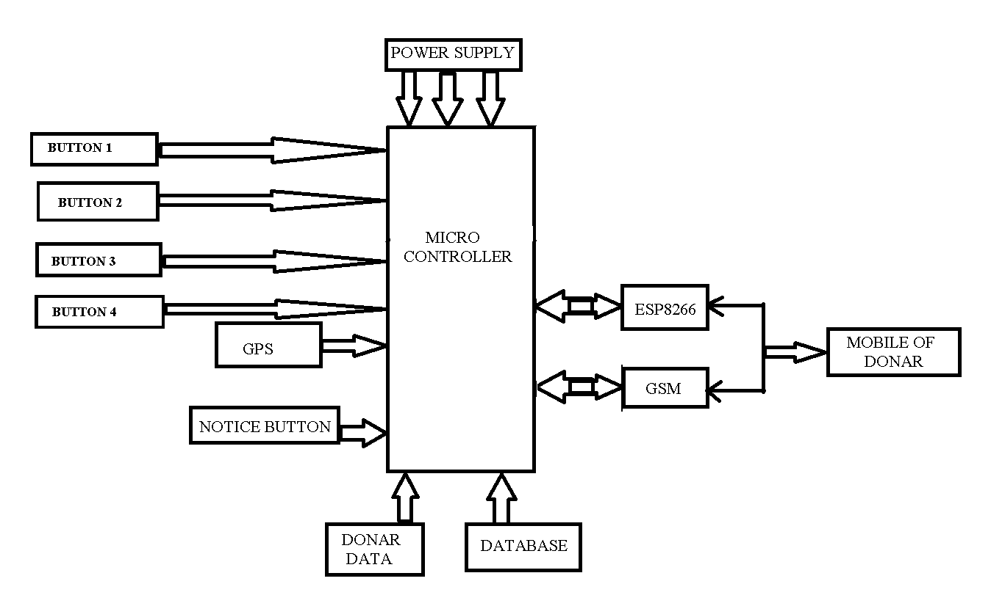
BLOCK DIAGRAM

Slide 11
CIRCUIT DIAGRAM

Slide 12
ADVANTAGES
This System doesn’t need compulsorily a mobile application for communicate with donor.
There is no need of internet for communicate with user and donor in our system.
This system doesn’t need any smart phone to communicate with donor and user.
Primary device only needs an internet connection even low power, Low bandwidth of internet enough to perform the task efficiently and save life.
This system will efficiently reach 1000+ people within 1 minute. So, this is time reduced task to reach a suitable donor.
This system is Low cost building, Easily to handle, Portable to use.

Slide 13
COMPONENTS USED
MICRO CONTROLLER(PIC16F877A OR ATMEL328)
ESP8266
IR LED
GPS
GSM
POWER REGULATOR
SERVER DATABASE
BUTTON
IoT APPLICATION

Slide 14
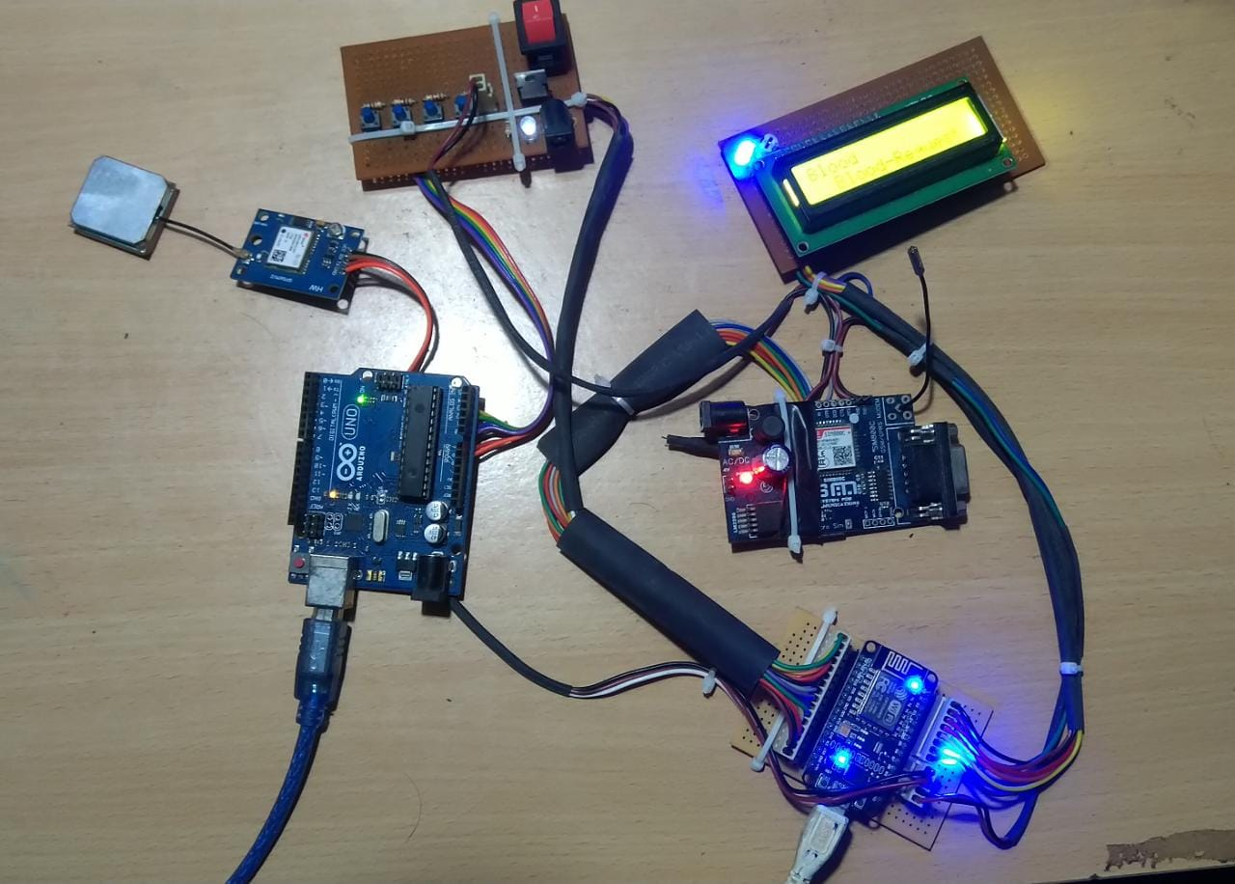
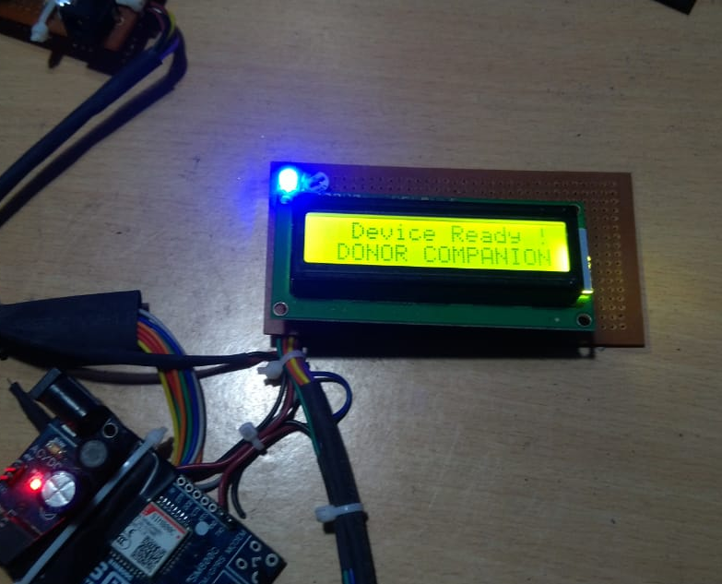
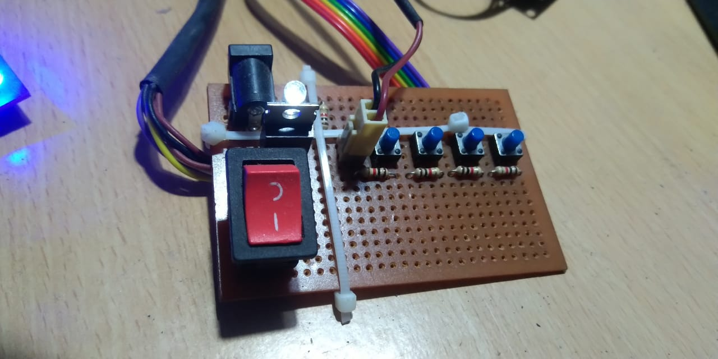
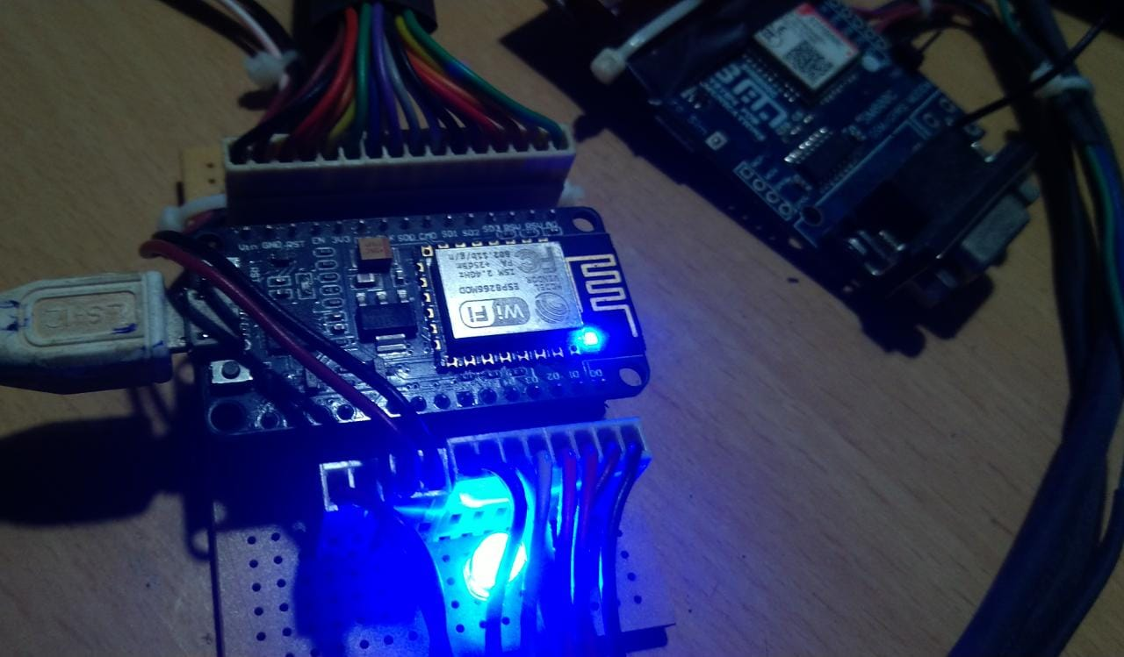
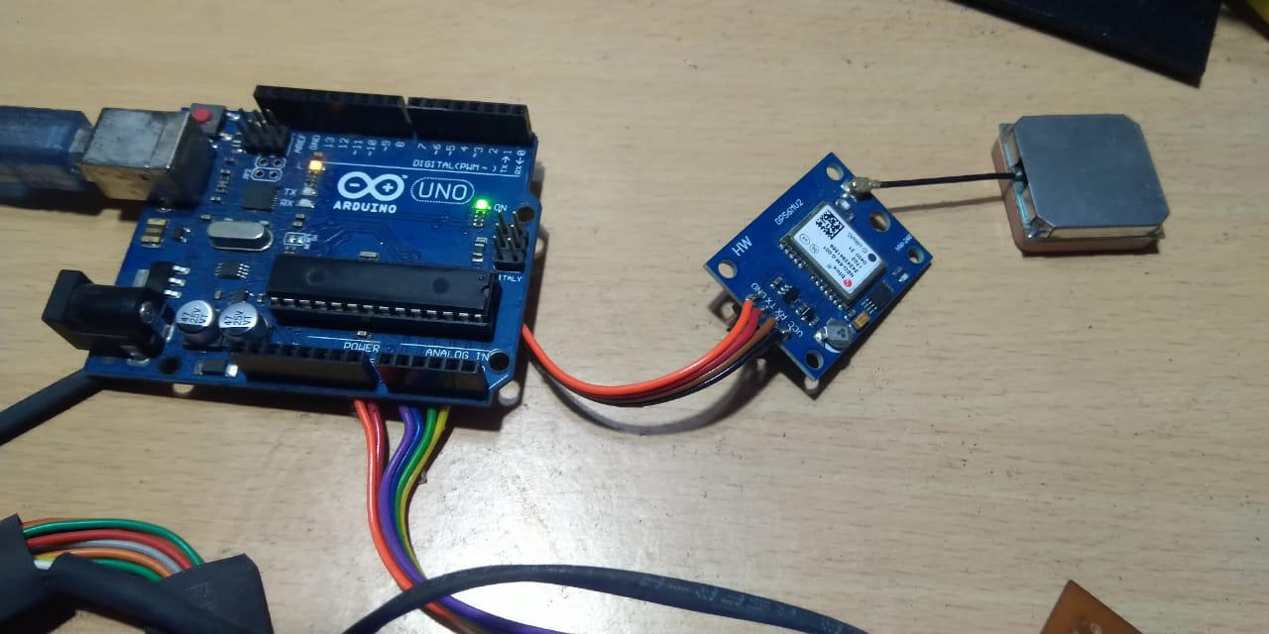
PROJECT KIT

Slide 15
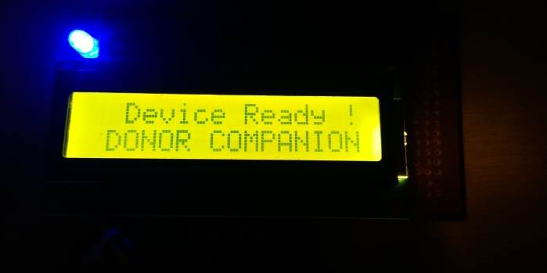
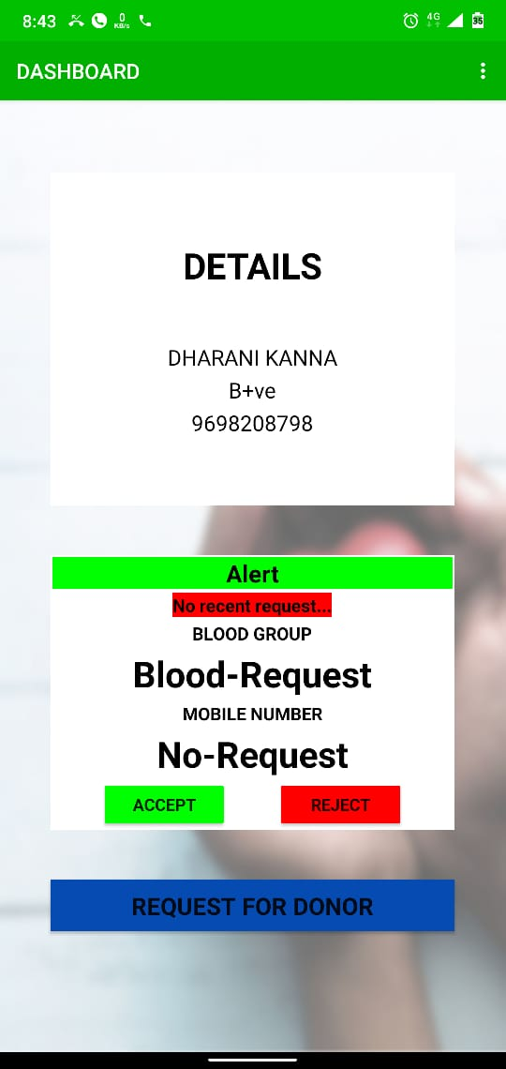
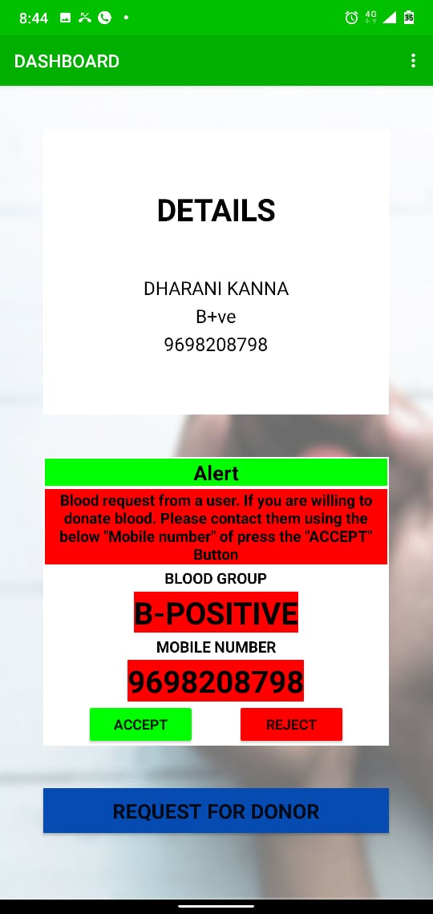
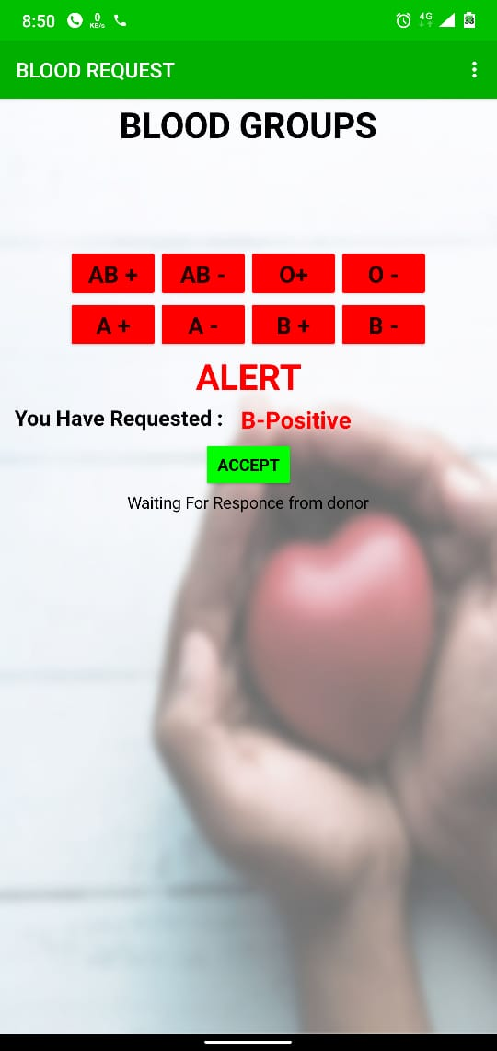
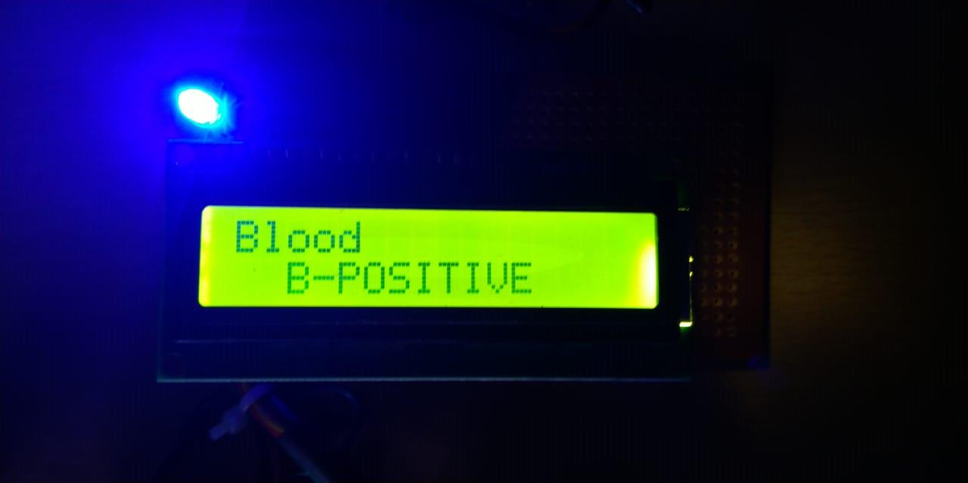
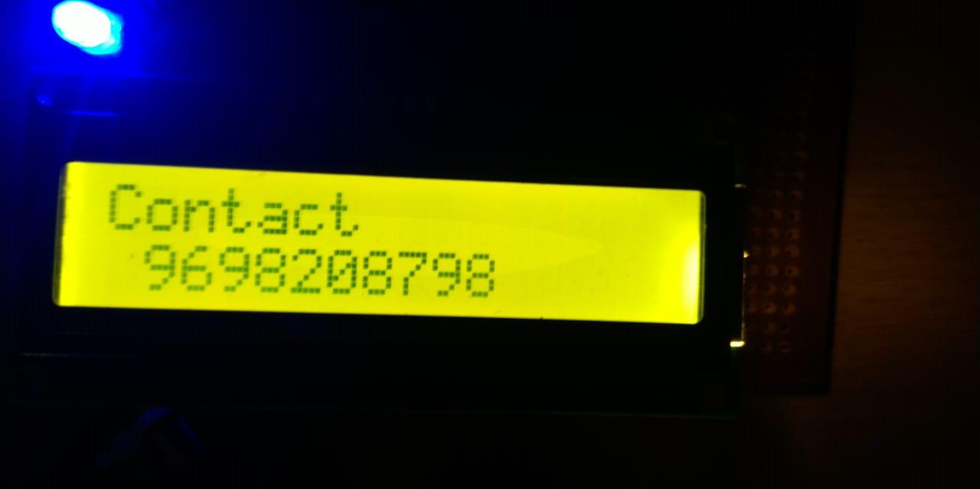
OUTPUT

Slide 16
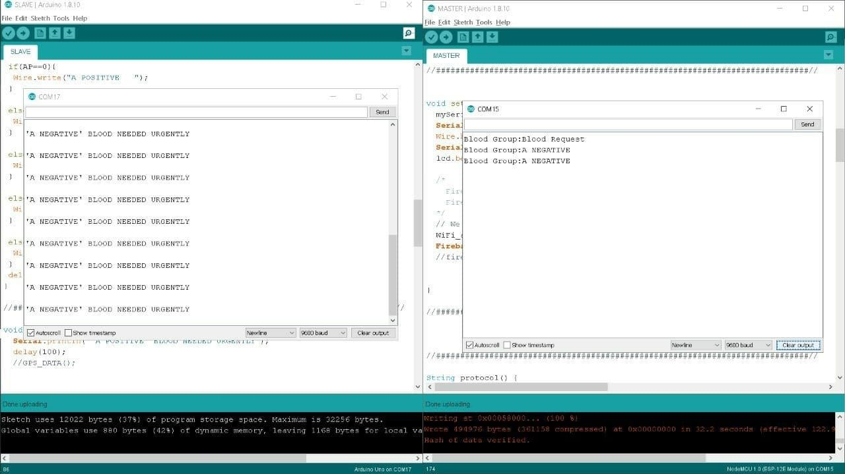

Slide 17
CONCLUSION
Conventional methods used to determine the blood group involves risk of infection, time consuming and reagents are required.
Alternate method for the Conventional method is Noninvasive method used to detect the blood type that cannot cause any infection, not required any reagent, time consuming
In future upgrade of project, we can also include to detect sugar level, BP range with this device for domestic health care purpose.
Adding tablet monitoring system with this system also make more reliable in future.

Slide 18
REFERENCE
[1] Prof . Snigdha et.al, “ Android Blood Bank “,International Journal of Advanced Research in Computer and Communication Engineering , vol 4 , Issue 11,November 2015 , pp:86-88 , ISSN(online) 2278-1021,ISSN(print):2319 5940.
[2] Narendra Gupta et.al , “MBB:A Life Saving Application “ , International Journal For Research in Emerging Science And Technology , vol 2 . Issue-1,March-2015 , pp:326330 , ISSN:2349- 7610 .
[3] Sultan Turhan , “An Android Application Volunteer Blood Donors “ , ICBB-2015 , DOI:10.5121/csit .2015.51103,pp:23-30
[4] Sayali Dhond et.al , “Android Based Health Application in Cloud Computin For Blood Bank “ ,International Engineering Research Journal(IERJ) vol 1 , Issue 9, 2015 , pp:868-870 , ISSN 2395- 1621.
[5] P.Priya et.al , “The Optimization of Blood Donor Information and Management System by Technopedia “ , International Journal of Innovative Research in Science Engineering Technology , vol 3, Issue 1,February 2014 ,pp:390-395, ISSN(online):2319-8753, ISSN(print): 2347-6710.
[6] R.Vanitha and P.Divyarani ,” BCloud App: Blood Donor Application For Android Mobile”, International Journal Of Innovations in Engineering and Technology(IJIET) ,vol.2 ,Issue 1,February 2013, pp:396-401 , ISSN:2319-1058.

